Slide 1
Hardware Description Language
HDL

Slide 2
Hardware Description Language
HDL
Describes circuits and systems in text.
As a software program.
Can be processed by computers.
VHDL, Verilog, AHDL, SystemC.
Applications:
Simulation
Synthesis

Slide 3
Simulation and Synthesis
Simulation
Input waveform and circuit description --> Output waveform
Predicts circuit behavior before fabrication (debug before physical implementation).
برنامه نويسي
کامپايل
اجرا
ويرايش

Slide 4
Simulation and Synthesis
Synthesis
Automatic design.
Software program takes design description and tries to find the circuit
ورود طرح
کامپايل
شبيه سازي
سنتز
شبيه سازي
ويرايش
ويرايش

Slide 5
Verilog HDL
Verilog or VHDL?
Similar concepts, different syntax
Similar to C/C++ Syntax
Case sensitive,
Comments: //
; at the end of each statement

Slide 6
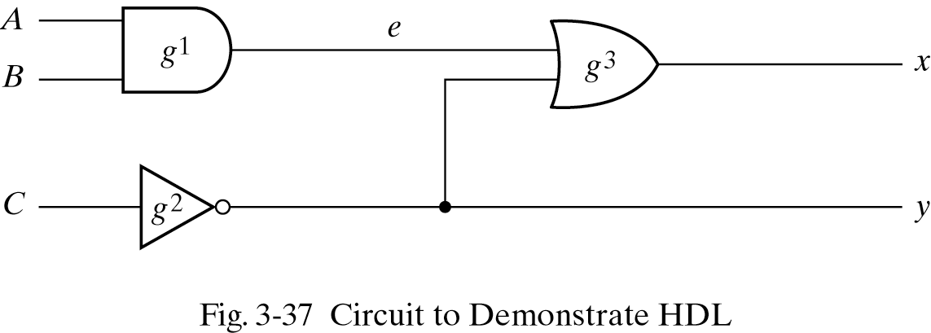
Example
module:
Hardware component
Ports:
As function parameters
But must specify input or output
wire:
Intermediate signals
//HDL Example 3-1
//--------------------------
module smpl_circuit(A,B,C,x,y);
input A,B,C;
output x,y;
wire e;
and g1(e,A,B);
not g2(y, C);
or g3(x,e,y);
endmodule
Concurrent Execution
Order not important.

Slide 7
Example
//HDL Example 3-1
//--------------------------
module smpl_circuit(A,B,C,x,y);
input A,B,C;
output x,y;
wire e;
and g1(e,A,B);
not g2(y, C);
or g3(x,e,y);
endmodule
Concurrent Execution
Order not important.

Slide 8
Delays
Timescale:
‘timescale 1ns/100ps
1ns: time unit
100ps: precision (unit used for rounding)
Default: 1ns/100ps (0.1 ns)
Gate Delays:
Used by simulator to generate correct waveforms

Slide 9
Delays
//HDL Example 3-2
//---------------------------------
//Description of circuit with delay
module circuit_with_delay (A,B,C,x,y);
input A,B,C;
output x,y;
wire e;
and #(30) g1(e,A,B);
or #(20) g3(x,e,y);
not #(10) g2(y,C);
endmodule

Slide 10
Testbench
Testbench:
Program written to test the circuit
Sets the input values,
Changes them over time.
Instantiates the module(s).
Inputs by reg (generally in sequential constructs)
Outputs by wire

Slide 11
Testbench Example
//HDL Example 3-3
//----------------------
//Stimulus for simple circuit
module stimcrct;
reg A,B,C;
wire x,y;
circuit_with_delay cwd(A,B,C,x,y);
initial
begin
A = 1'b0; B = 1'b0; C = 1'b0;
#100
A = 1'b1; B = 1'b1; C = 1'b1;
#100 $finish;
end
endmodule
//Description of circuit with delay
module circuit_with_delay (A,B,C,x,y);
input A,B,C;
output x,y;
wire e;
and #(30) g1(e,A,B);
or #(20) g3(x,e,y);
not #(10) g2(y,C);
endmodule
Testbench:
Doesn’t have port.
Instantiation.
<size>’<base><value>
Base: b, o, d, h
32’d87
ABC = “000” → “111”
100ns delay.
Finishes at 200ns.

Slide 12
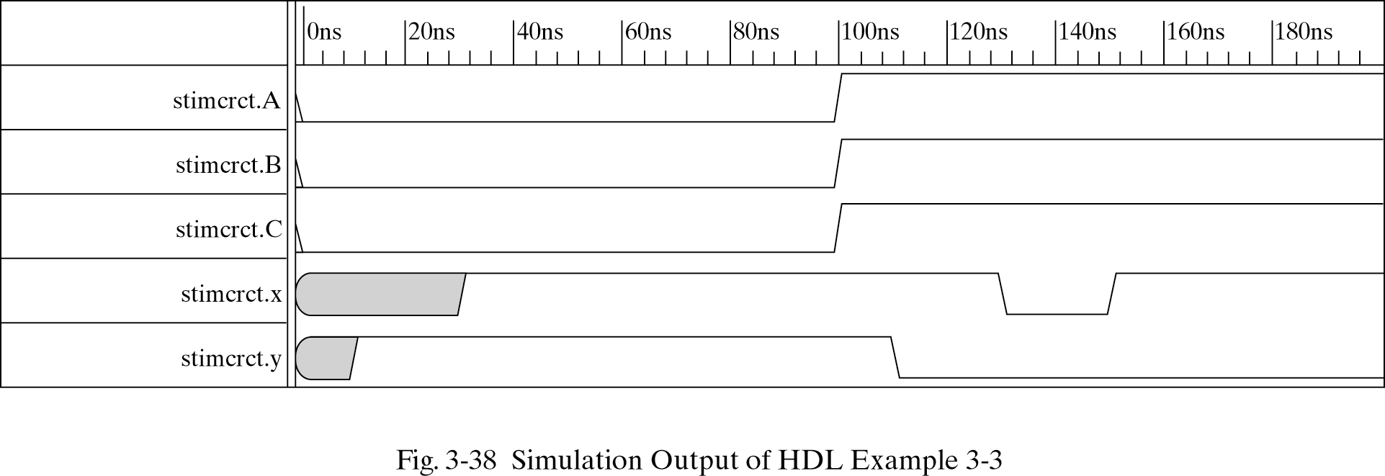
Testbench Example

Slide 13
Boolean Expressions
& AND
| OR
~ NOT
assign x = (A & B) | ~C;
//HDL Example 3-4
//------------------------------
//Circuit specified with Boolean equations
module circuit_bln (x,y,A,B,C,D);
input A,B,C,D;
output x,y;
assign x = A | (B & C) | (~B & C);
assign y = (~B & C) | (B & ~C & ~D);
endmodule

Slide 14
Primitives
Built-in Primitives:
and, or, not, nand, nor, xor, xnor, buf.
User-Defined Primitives (UDP):
User can define by truth table.

Slide 15
Primitives
User-Defined Primitives (UDP):
User can define by truth table.
Use primitive keyword (instead of module)
Only one output but many inputs
first output, then inputs
Inputs’ order must correspond with the truth table.
Truth table between table and end table.

Slide 16
UDP
//HDL Example 3-5
//-----------------------------------
//User defined primitive(UDP)
primitive crctp (x,A,B,C);
output x;
input A,B,C;
//Truth table for x(A,B,C) = Minterms (0,2,4,6,7)
table
// A B C : x (Note that this is only a comment)
0 0 0 : 1;
0 0 1 : 0;
0 1 0 : 1;
0 1 1 : 0;
1 0 0 : 1;
1 0 1 : 0;
1 1 0 : 1;
1 1 1 : 1;
endtable
endprimitive

Slide 17
UDP Usage
Usage: much the same way as a system-defined primitives:
crctp #(20) myInstance(w, x, y, z);

Slide 18
Simulation
ModelSim:
An industrial and widely used simulator
$25K

